Slide 1
Boot Camp Project 2 Proposal
Ahmeda, ZiAng, Molly, Dale
gibhub repo

Slide 2

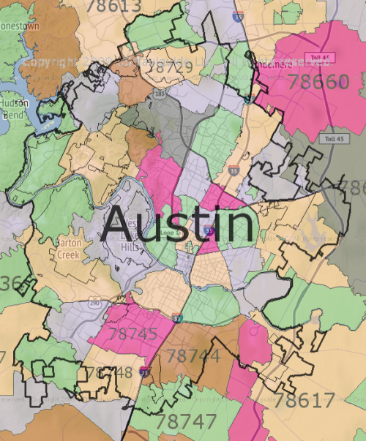

Quick Project Overview
Map of animals intake / outtake at Austin Animal Control
Overlay intake / outtake on map
Color the map by demographics (income?)
Size of marker by number of animals (or multiple circles for animal types?)
Maybe a single circle for animals, and when you click on it, it breaks out to animal types.
Scatter plot of demographics vs animal intake OR outtake (adoption).
This would allow a user to select between intake and outtake
Histogram of intake, outtake
X-Axis zip code
Y-Axis intake or outtake (selectable)
Color could be by zip code, income level or other demographic data we might pull in
Use APIs to collect the animal control data, which changes daily
Demographic data is probably a one-time pull, it doesn’t change fast
Intake
Outtake

Slide 3
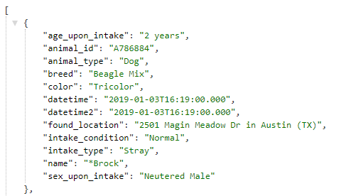
Requirements
Interactive web page driven with Flask
Data sources
Austin Animal Center API
Demographicss by Zip Code
TBD, probably US Census
Had to install sodapy to use Socrata to get this
Data to be stored in MySQL db
Animal Center updates daily, option to update from API with a button click? Or update upon entry to web page?
Demographic data will be downloaded to our db one time
Display – Combination of Leaflet mapping and Plotly tables
One interactive map, one interactive bubble chart, one interactive bar chart
Use Python goepandas library for goecoding
Challenges
Convert Austin address to lat/lon and zip code
Lat/lon for geocoding on map display
Zip code for matching to demographic data
“Austin, TX” data to go to Animal Center location

Slide 4
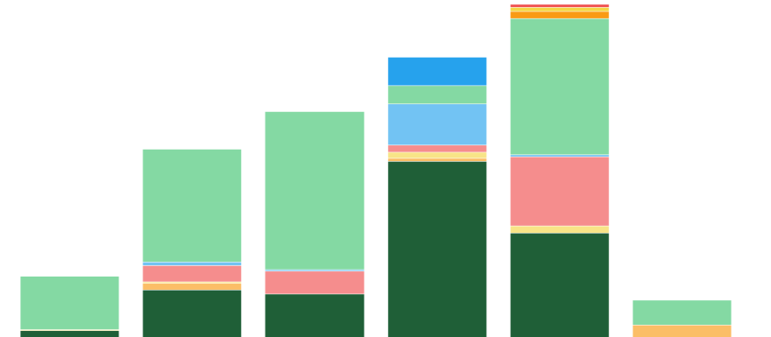
Austin Animal Center Statistics
Filters
Maps
Layers
Filters
Dogs
Cats
Zip Code
Intake
Dogs
Other
Demographic
Outtake
Cats
Intake
Other
Outtake
Number of cases
Demographics
Income
Ethnicity
Other?
Colors
Pet Type
Demographics
Zip Code

Slide 5
Project 2 Data Checklist
Ahmeda, Dale, Molly, and ZiAng
Base map layers
Our visualization 1 will be an interactive map. Here’re the data used for the map layers:
Base map: https://www.openstreetmap.org
Polygons (for zip codes, etc): https://www.openstreetmap.org/traces
Also polygons: https://www.census.gov/geo/maps-data/data/cbf/cbf_zcta.html
Input datasets
We plan to get out input data from the following sources -
Main data – Austin shelter animals’ intake:
https://data.austintexas.gov/Health-and-Community-Services/Austin-Animal-Center-Intakes/wter-evkm
In map form (maybe for our reference):
https://data.austintexas.gov/Health-and-Community-Services/Austin-Animal-Center-Found-Pets-Map/hye6-gvq2
Support data – Austin income by zip code:
http://zipatlas.com/us/tx/austin/zip-code-comparison/median-household-income.htm

Slide 6
Building the DB
We will build a mySQL db with two tables
Austin income by zip code
Scraped from zipatlas
Austin Animal Center
API interface at data.austintexas.gov
Must add zip code and lat/lon to this db by geocoding
Data can then be merged by zip code or lat/lon to build the views we want to build
In map view
Tags for locations must be lat/lon
Zip code level polygons on map
Polygons to be colored by user choice
Income (probably heat map style)
# of intake
# of outtake

